Slide 1
Trade Deficits and Exchange Rates
Presentation to …
January 30, 2023
Alan Deardorff
University of Michigan

Slide 2
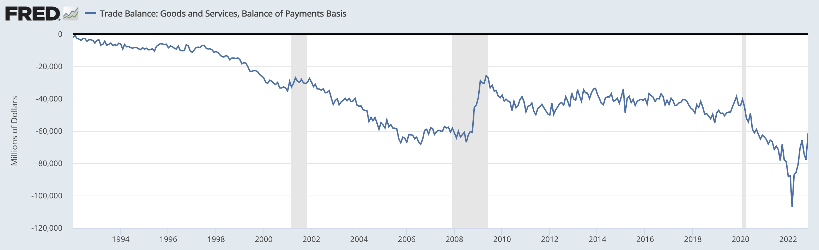
US Trade Balance = Exports minus Imports
Clinton
Bush
Obama
Trump
Biden
Note the zero. This whole thing is negative – a trade deficit! – and getting mostly larger since 1992.
Recessions
Notes:
FRED,
https://fred.stlouisfed.org/series/BOPGSTB

Slide 3
US Exchange Rate
Source: Federal Reserve
Notes:
https://www.federalreserve.gov/releases/h10/summary/jrxwtfb_nm.htm
Jan 15, 2023
Presentations/OLLI/Trade Deficits & Exchange Rates/Dollar Index Broad.xlsx

Slide 4
Outline
The trade deficit
  How it’s defined
  How it has changed over time, US and other
  What it means and does not mean
Exchange rates
  What they are
  How they are determined
  How they have changed over time, US and other
  How they matter
  Currency manipulation (if time allows)

Slide 5
Trade Deficit
The trade balance
  Defined as Exports minus Imports, X–M
  May be reported for goods only, or for goods and services
When trade balance is negative, that’s a trade deficit
  Thus trade deficit is Imports minus Exports, M–X
The US:
  Has had a deficit for many decades
  It has grown substantially in recent years
  Has had a surplus for trade in services
Another measure: “The Current Account Balance”
  This is the trade balance plus:
    International income flows (interest, dividends, profits, wages)
    International transfer payments (e.g., remittances, aid)
  Not very different from the trade balance

Slide 6
US Trade Balance: Goods and Services
Notes:
FRED,
https://fred.stlouisfed.org/series/BOPGSTB

Slide 7
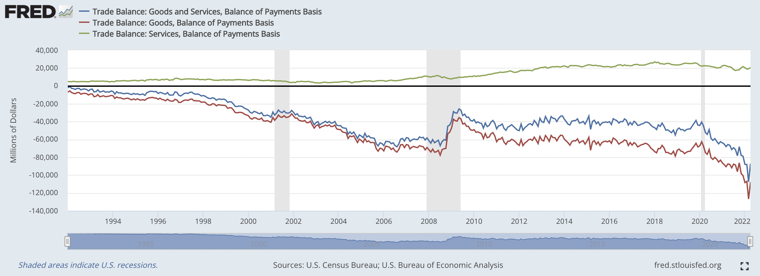
US Trade Balances
Examples of services trade:
Professional (legal, engineering, accounting)
Banking
Computer
Construction
Logistics
Services Only
Goods and Services
Goods Only
Notes:
FRED,
https://fred.stlouisfed.org/series/BOPGSTB
[I can’t figure out now how I got all these in one.]

Slide 8
Trade Deficit
For the World as a Whole
  Since one country’s imports are another’s exports
  ↳ The sum of all deficits and surpluses must be zero
Therefore US deficit implies rest of world has surplus
But many countries have deficits

Slide 9
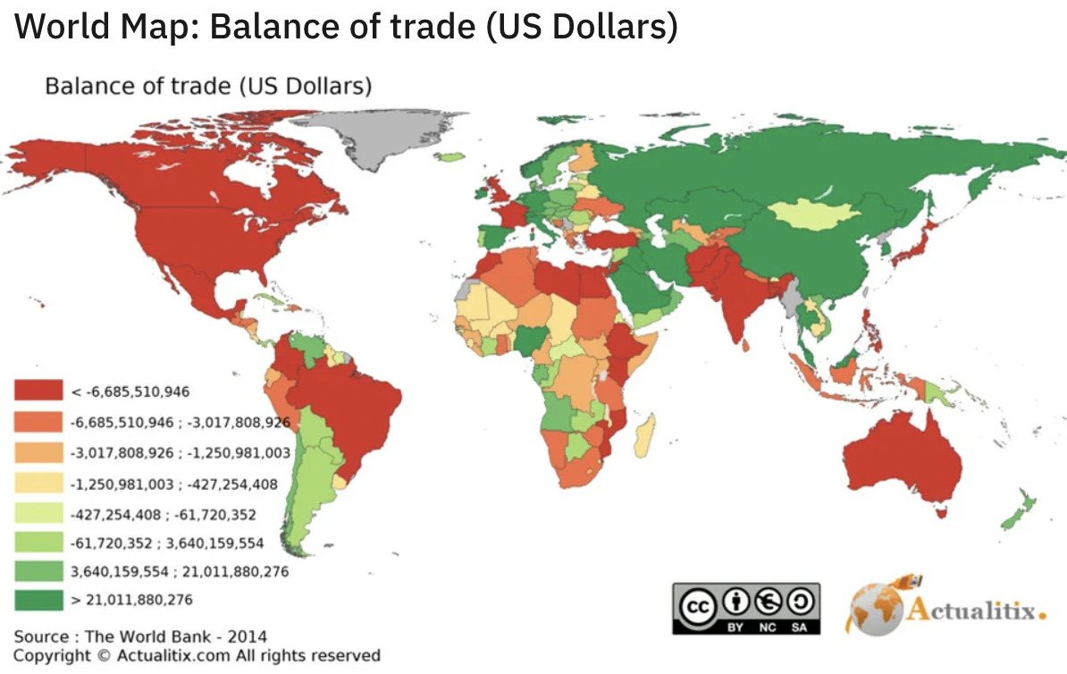
Source:
Reddit
Notes:
https://www.reddit.com/r/MapPorn/comments/douqh9/world_map_balance_of_trade_us_dollars/

Slide 10
Trade Balances Over Time
China
Germany
Japan
Canada
Mexico
Source:
IMF International Financial Statistics
US
Notes:
https://data.imf.org/?sk=4C514D48-B6BA-49ED-8AB9-52B0C1A0179B&sId=1409151240976
Projects/Data for Presentations/IMF/Country Current Accts/Trade Balance 6 Countries.xlsx
External Sector, Balance of Payments, Current Account, Goods and Services, Net, US Dollars, BGS_BP6_USD, Millions

Slide 11
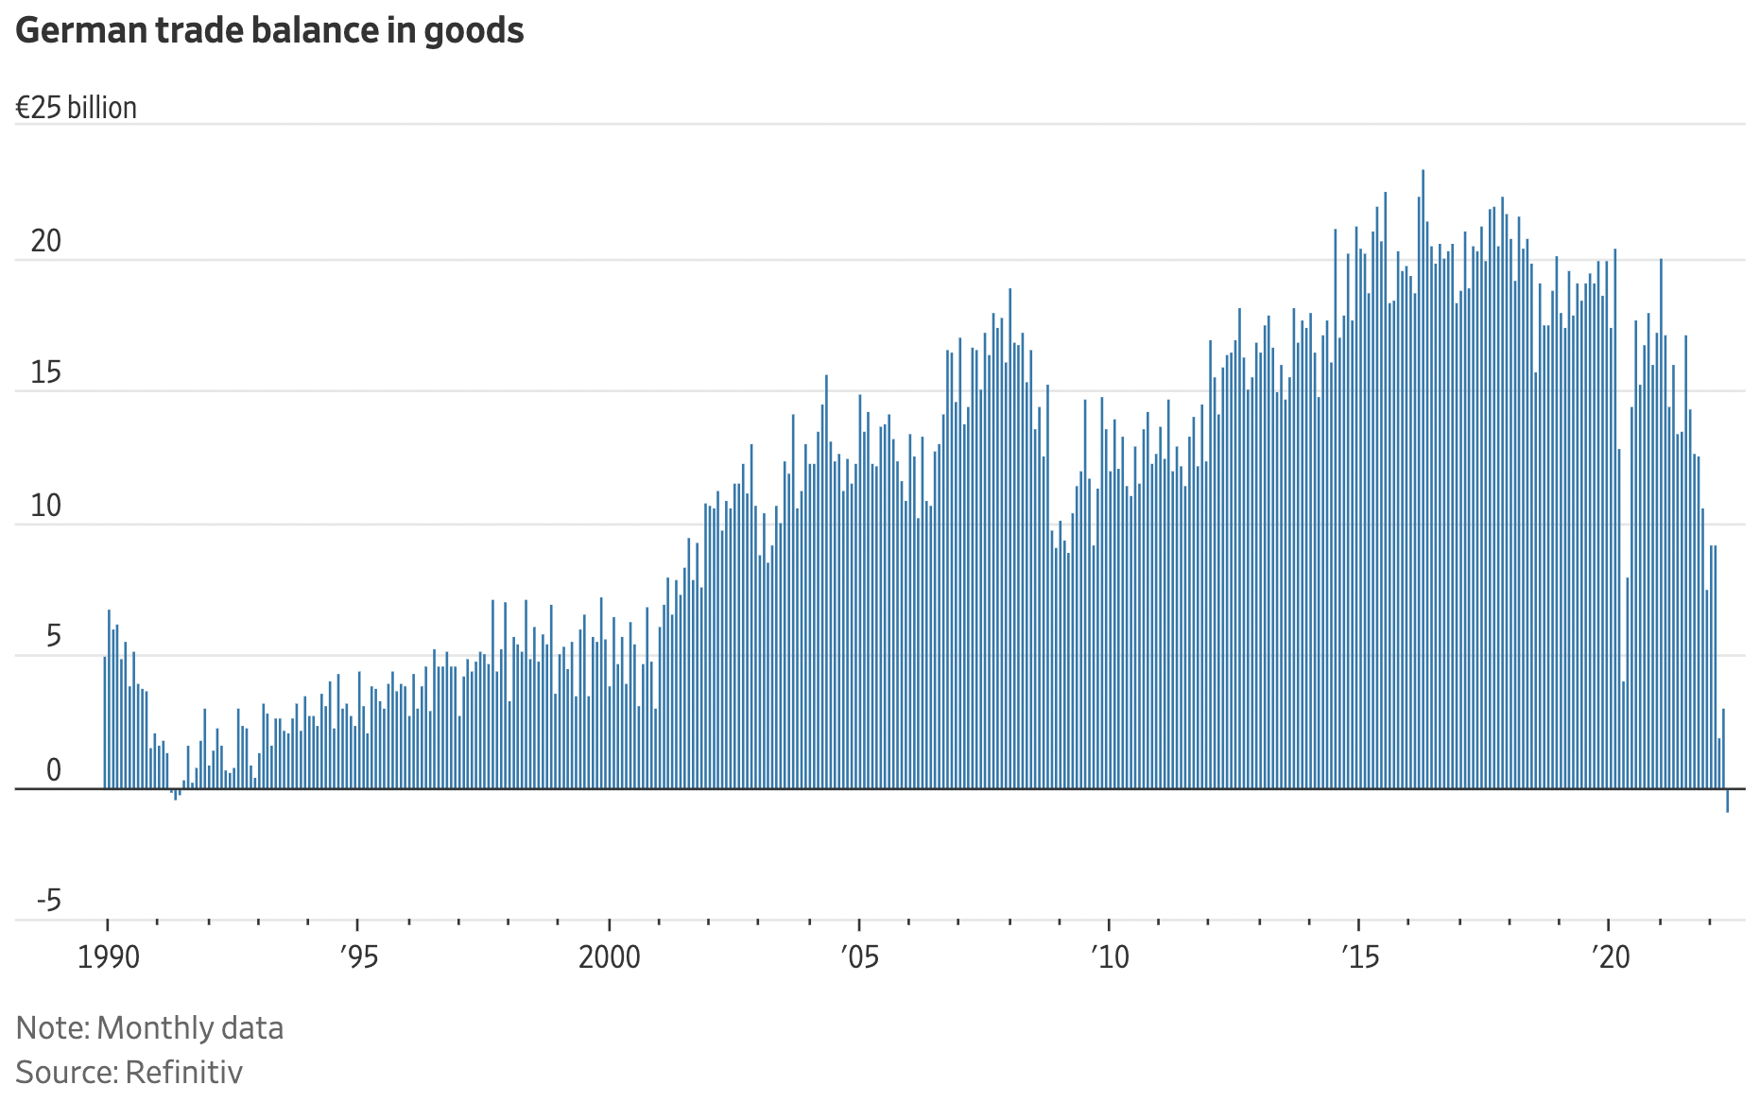
Trade Balances Over Time
But note the recent data for Germany:
Negative for first time since 1991
Source:
WSJ, 7/11/22
(This was based on preliminary data. Revised data a month later showed a small surplus.)
Notes:
James Mackintosh, “Strong Dollar Wins the Inflation Battle in New Spin on Currency Wars,” Wall Street Journal,” July 11, 2022
https://www.wsj.com/articles/strong-dollar-wins-the-inflation-battle-in-new-spin-on-currency-wars-11657369125?mod=itp_wsj&ru=yahoo
Revised data: https://www.reuters.com/markets/europe/german-exports-surge-record-level-june-2022-08-03/

Slide 12
Trade Deficit
What a trade deficit means
  Imports > Exports
  The gap must be paid for somehow. By
    Capital inflows (borrowing, sale of stocks & bonds)
    Sale of property (real estate, companies)
    Gifts from foreigners (not relevant for US)
    Others willing to hold more or our currency (very relevant for US)
  What explains the gap? Look at GDP (Gross Domestic Product), which measures both production and income in a country:
GDP = C + I + G + X – M

Slide 13
What a Trade Deficit Means
Production
GDP = C + I + G + X – M
Consumption
= Household spending
Investment
= Business spending on equipment and inventories (not inputs)
Imports
(Subtracted because C, I, and G all include imports)
Exports
Government
= Purchases by government at all levels

Slide 14
What a Trade Deficit Means
Income
Expenditure
Trade Balance
GDP = C + I + G + X – M
OR:
Trade Balance
Income
Expenditure
X – M = GDP – (C + I + G)
Therefore
  Trade Surplus = Income minus Expenditure
  Trade Deficit = Expenditure minus Income
Running a trade deficit means we are spending more than our income

Slide 15
What a Trade Deficit Means
For another interpretation, subtract net taxes from both sides
T = Net Taxes = Taxes – Transfers
GDP – T = C + I + G – T + X – M
(GDP – T – C) + (T – G) – I = (X – M)
Private Saving
Gov’t Saving
Investment
Trade Balance
Total Saving
Trade Balance = Saving minus Investment

Slide 16
What a Trade Deficit Means
Trade Balance = Saving minus Investment
Therefore
  If a country is saving more than needed to finance domestic investment, it will, by definition, run a trade surplus
  If a country is saving less than needed to finance domestic investment, it will, by definition, run a trade deficit
That gap is also, as before, the difference between total income and total expenditure
It therefore also appears as
  Net borrowing and lending
  Plus net acquisition or sales of assets

Slide 17
What a Trade Deficit Does NOT Mean
There are several very popular interpretations of trade deficits that are simply NOT valid, even though many politicians believe them:
  That foreign trade barriers are hurting our exports
  That other countries are engaged in unfair trade
  That our firms are not competitive
  That we are losing jobs to other countries
  That we need to restrict trade
To understand why these are wrong, think about whether they could change
  Expenditure relative to income, or
  Saving relative to investment
Possible exception: If we are in recession and these may change income
  But note that the trade deficit typically falls during recession, due to recession reducing expenditure

Slide 18
US Trade Balance: Goods and Services
Note that we may be in a recession now.
Recessions

Slide 19
US Trade Deficit
The US trade deficit means that the US is spending more than its income. How much?
  $861 billion in 2021, according to the IMF
  How does that compare to US GDP? GDP was $23 trillion.
  So US trade deficit was about 3.7% of US GDP
  Collectively, we and our government are spending almost 4% above our income.
  How does that compare to other countries?

Slide 20
Trade Balance / GDP
of US and It’s Top Ten Trading Partners, 2019
US | Trade w US
 | $ billions
Canada | 619.0
Mexico | 617.7
China | 579.1
Japan | 221.6
Germany | 189.7
S. Korea | 136.8
UK | 133.2
France | 97.2
India | 94.3
Italy | 82.5
= 2.7% (grew to 3.7% in 2021)
Source:
IMF International Financial Statistics
Trade balance includes goods and services
Notes:
Data for Presentations/Country data.xlsx

Slide 21
Trade Balance / GDP
Sample countries, 2019
Singapore | 36.9 %
Ireland | 12.4%
Switzerland | 9.8%
Germany | 5.7%
China | 0.9%
Japan | –0.2%
US | –2.7%
Romania | –4.1%
Ukraine | –8.1%
Philippines | –9.6%
Haiti | –24.5%
Guyana | –62.2%
Source:
IMF International Financial Statistics
Trade balance includes goods and services
Notes:
Data for Presentations/Country data.xlsx

Slide 22
US Trade Deficit
Is it a problem?
  Yes, if others are unwilling to lend to us or to hold our assets (& our money)
  But US, at least for now, has both a strong currency and a strong economy
    Others trust assets in the US more than others
    They also rely on US dollars for transactions and reserves
    We have an “Exorbitant Privilege” because of the US dollar’s role in the world economy (said by Valery Giscard d'Estaing in the 1960s) when most currencies were pegged to dollars, but still valid today)

Slide 23
US Trade Deficit
Is it a problem?
  It does mean that US net debt to foreigners grows every year.
  What if other countries decide to dump their dollar assets? Their value would plummet and they would lose. (But runs on currencies, like runs on banks, do happen.)
  US net international investment position recently reached –$18 trillion!

Slide 24
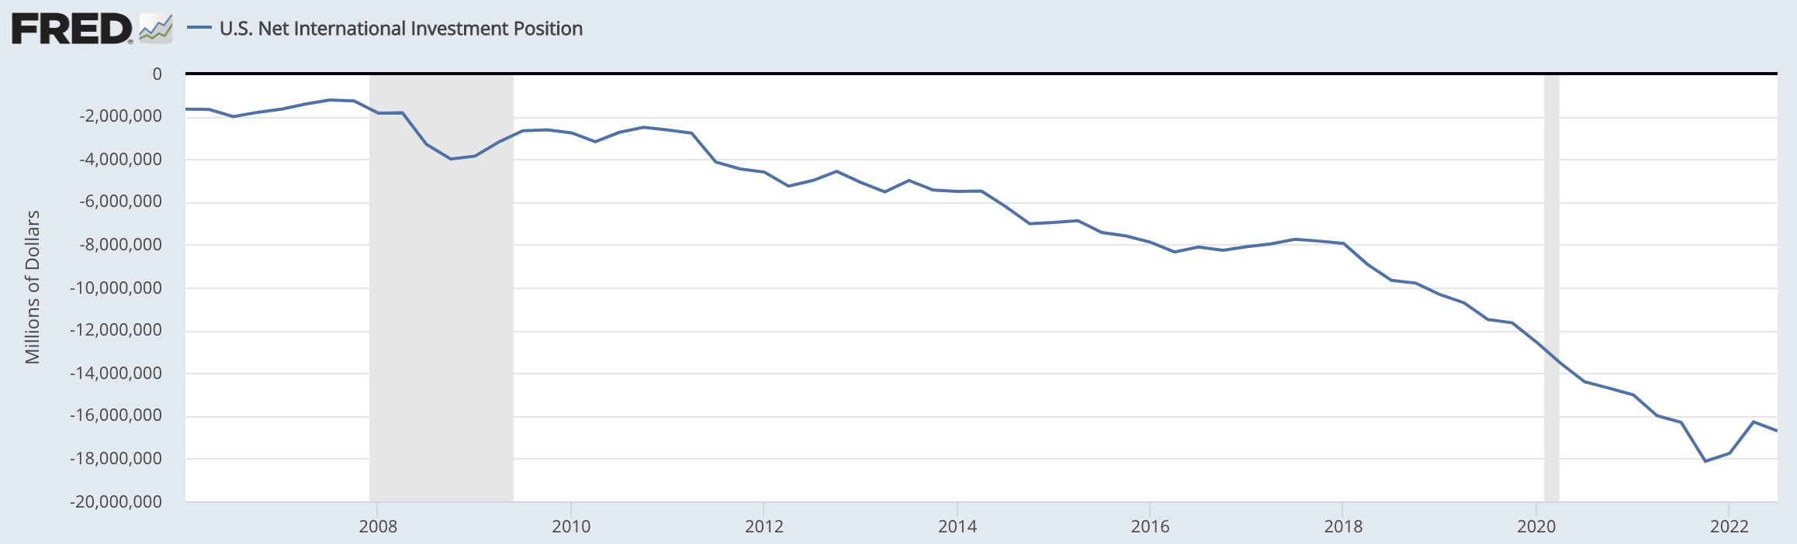
US Net International Investment Position
With US population 332 million, that’s over $50,000 per person, or about twice that per household.
Notes:
https://fred.stlouisfed.org/series/IIPUSNETIQ

Slide 25
US Trade Deficit
Is it a problem?
  Yes, in my view, but not because it might hurt us. Because it takes advantage of others.
  The US, one of the richest countries in the world, is
    Spending more than its income
    Being funded, in part, by much poorer countries
  We are enjoying
    More goods and services than we produce
    Produced by often lower-wage and poorer workers abroad
    Without, at least in the foreseeable future, paying for them
  That just feels wrong to me,
    Especially if others are financing us not by choice but because they have no other option.

Slide 26
US Trade Deficit
Could an increase in the trade deficit ever hurt us?
  Yes, if we are in a recession.
  Then by demanding foreign goods and services instead of our own, we support jobs abroad instead of at home
  That is when using trade policy and/or exchange-rate policy to promote demand and higher employment at home seems to make sense.
    But it helps us only at the expense of others, if they are also in recession
    And it is likely to cause retaliation, cancelling all or more than any benefit

Slide 27
Trade Deficits and Exchange Rates
Do exchange rates matter for trade deficits?
  Yes.
  If your currency falls in value, it makes
    Exports cheaper
    Imports more expensive
    Lowers real income and therefore expenditure
    Result: Trade balance “improves”
      Deficit shrinks, or
      Surplus grows
  Example of the opposite, dollar appreciation: Volker policy in 1980-81
    Raised US interest rates (to fight inflation)
    ↳ Attracted capital from abroad
    ↳Caused the US dollar to rise in value by about 50%
    ↳Hurt US exports, helped imports, and increased the US trade deficit

Slide 28
Pause
Pause for
  Questions
  5-Minute Break
Next: Exchange Rates

Slide 29
Exchange Rates
What they are
  The price of one currency in terms of another
  Thus, for example
    The number of dollars you pay for one euro: $/€
    Or, the number or euros you’ll get for one dollar: €/$
  Rates reported in data are from transactions between major banks
  Rates you see in banks, stores, and currency exchanges will be worse for you
    To cover cost and make profit for them

Slide 30
Exchange Rates Can Be Confusing
Confusing in how they are reported
  Hard to know what is up and what is down
    i.e., “The Japanese yen rose today from 152 to 144” (10/21/22)
    Makes sense because the numbers are understood to be ¥/$, not $/¥, so the change from 152 to 144 is in fact a rise in the value of the yen
  Yen is reported that way because alternative would be
    “The Japanese yen rose today from $0.0066 to $0.0069”
  For currencies worth much less than $1, scales often show currency/$
    Graphs of rates over time may be drawn on an “inverted scale”
    Or alternatively, “strength” may appear as a drop on the graph

Slide 31
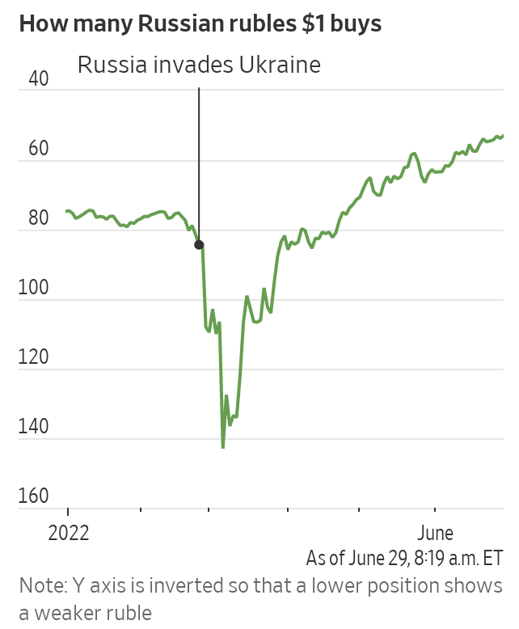
Russia’s Surprising Economic Headache: A Strong Ruble
Wall Street Journal
June 29, 2022
Notes:
McCabe, Caitlin and Kate Vtorygina, “Russia’s Surprising Economic Headache: A Strong Ruble,” Wall Street Journal, June 29, 2022.
https://www.wsj.com/articles/russias-surprising-economic-headache-a-strong-ruble-11656530936

Slide 32
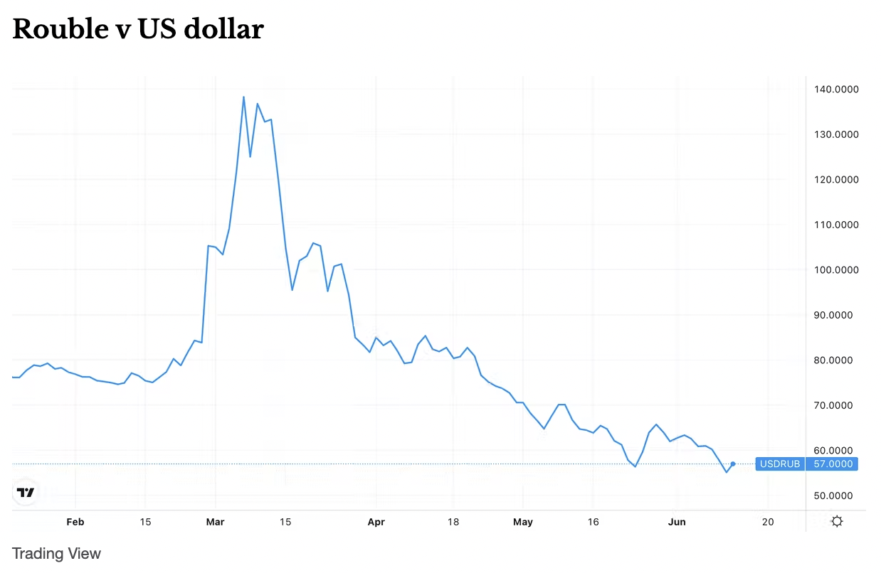
Russia’s rouble is now stronger than before the war
The Conversation
June 13, 2022

Slide 33
Exchange Rates Can Be Confusing
Confusing in the names for currencies
  Different names or spellings for the same currency
    Russia: ruble vs. rouble (see above)
    China: yuan vs. renminbi
    UK: pound vs. sterling
  Different countries with the same-named currency
    Dollar: Australia, Canada, Hong Kong, US, …
    Peso: Argentina, Chile, Colombia, Mexico
    Pound: Egypt, Lebanon, UK
  Different-named currencies use the same symbol
    ￥: Japan’s yen, China’s yuan

Slide 34
What Determines Exchange Rates
Exchange rates are determined in markets
Thus they respond to changes in demand and supply

Slide 35
What Determines Exchange Rates
Main sources of demand for our country’s currency
  Increases that cause our currency to rise (or “appreciate”):
  Exports, i.e., foreign purchases of our
    Goods
    Services
  “Capital inflows,” i.e., foreign purchases of our
    Stocks
    Bonds
    Currency

Slide 36
What Determines Exchange Rates
Main sources of supply of our country’s currency
  Increases that cause our currency to fall (or “depreciate”):
  Imports, i.e., our purchases of foreign
    Goods
    Services
  “Capital outflows,” i.e., our purchases of foreign
    Stocks
    Bonds
    Currencies

Slide 37
What Determines Exchange Rates
So changes that cause our currency, the $, to rise in value:
  More US exports and/or less US imports
  Rise in US interest rates and or fall in foreign interest rates
  New expectation that dollar will rise
    Causes wealth holders to buy more $ assets
  Other central banks choose to hold more $ in reserves
Opposites of above cause the $ to fall

Slide 38
What Determines Exchange Rates
Historic Roles of Governments and Central Banks
  Define the value of currency in terms of gold or silver
    The Gold Standard of the 19th and early 20th century
  Intervene in markets to “peg” their currency to another
    The Dollar Standard of 1945-1973
      Most currencies were pegged to the US $
      Other central Banks bought and sold dollars to achieve this.
  Let major currencies “float” since 1973
    Many weaker countries still intervene in markets, buying or selling to
      Peg to another currency
      Reduce currency fluctuations
    A few intervene in markets to “manipulate” their currencies
      Reduce their value to encourage exports

Slide 39
How Have Exchange Rates Changed
We’ll look at
  US dollar
  France, Germany, Italy, and Euro Area’s euro
  Canadian dollar
  Mexican peso
  British pound
  Japanese yen
  Chinese renminbi

Slide 40
US Exchange Rate
Rose because US had lower inflation than others
Source: Federal Reserve
Notes:
https://www.federalreserve.gov/releases/h10/summary/jrxwtfb_nm.htm
Jan 15, 2023
Presentations/OLLI/Trade Deficits & Exchange Rates/Dollar Index Broad.xlsx

Slide 41
US Exchange Rate
Dollar rose due to Volker Interest rate rise, fighting inflation.
Caused severe recession in US.
Source: Federal Reserve
Notes:
https://www.federalreserve.gov/releases/h10/summary/jrxwtfb_nm.htm
Jan 15, 2023
Presentations/OLLI/Trade Deficits & Exchange Rates/Dollar Index Broad.xlsx

Slide 42
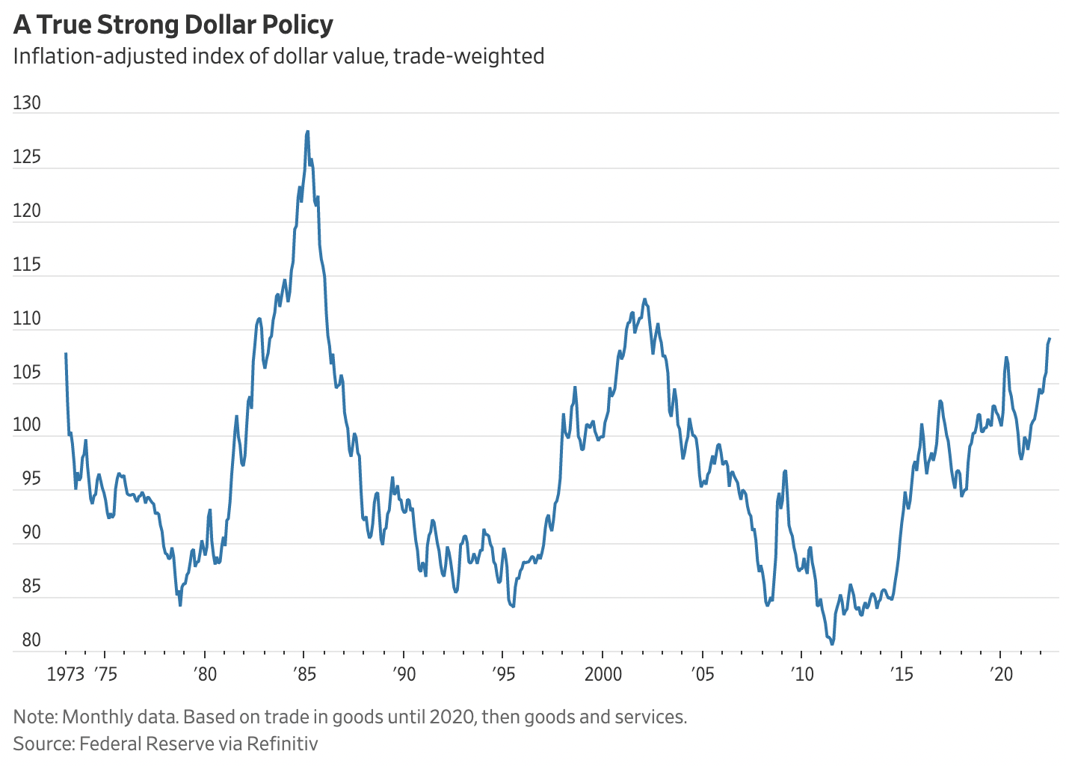
US Exchange Rate
Source:
WSJ, 7/11/22
Notes:
James Mackintosh, “Strong Dollar Wins the Inflation Battle in New Spin on Currency Wars,” Wall Street Journal,” July 11, 2022
https://www.wsj.com/articles/strong-dollar-wins-the-inflation-battle-in-new-spin-on-currency-wars-11657369125?mod=itp_wsj&ru=yahoo

Slide 43
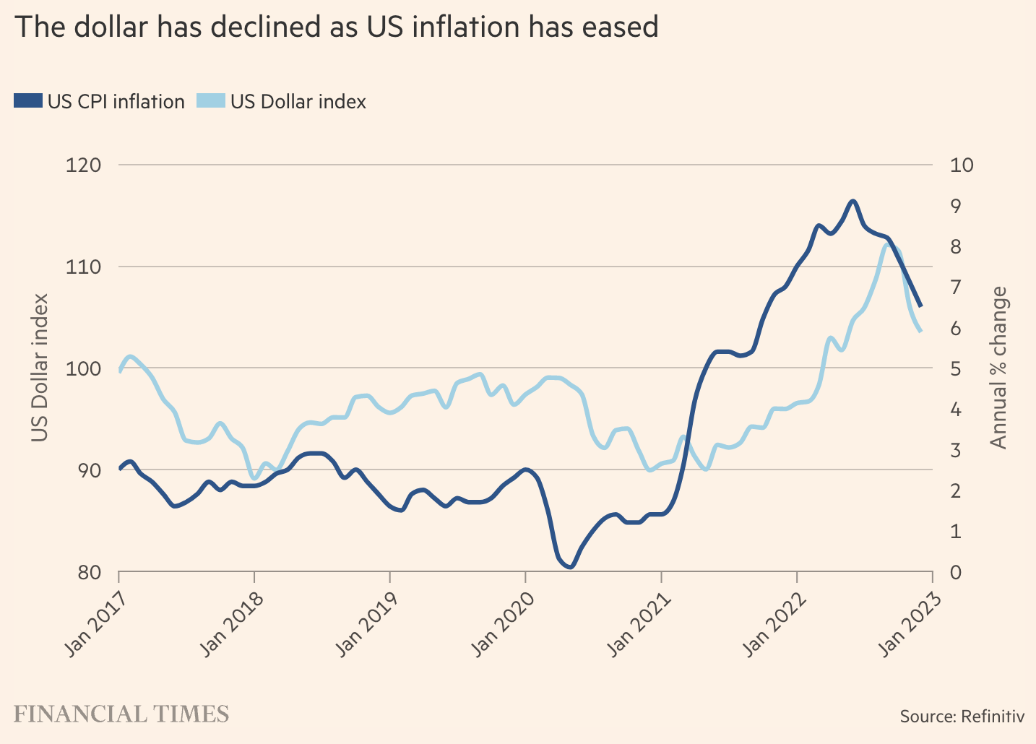
US Exchange Rate
Source:
FT, 1/17/23
Notes:
Rebecca Patterson, “The downturn in the dollar is not just about rates,” Financial Times, January 17, 2023.
https://www.ft.com/content/4de92f95-9bd6-487d-822c-e3872f2f8da4

Slide 44
Dollar Value of Other Currencies
Rates floating
Germany
Rates pegged to US$, with only occasional changes
France
Italy’s currency, the lira, was worth less than 1/10 of a cent
Source:
IMF International Financial Statistics
Notes:
https://data.imf.org/regular.aspx?key=61545850
Data for Presentations/IMF/Country Exchange Rates.xlsx
Domestic Currency per U.S. Dollar, Period Average, Rate, ENDA_XDC_USD_RATE, Units

Slide 45
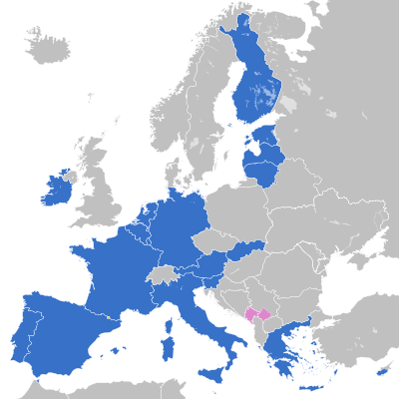


Euro Area
Croatia adopted the euro January 1, 2023.

Slide 46
Dollar Value of Other Currencies
Rates here are scaled up to match value of euro in 1998.
Italy
In preparation for the common currency, countries sought to get their currencies to move together
France
Euro Area
Source:
IMF International Financial Statistics
Germany
Notes:
https://data.imf.org/regular.aspx?key=61545850
Data for Presentations/IMF/Country Exchange Rates.xlsx
Domestic Currency per U.S. Dollar, Period Average, Rate, ENDA_XDC_USD_RATE, Units

Slide 47
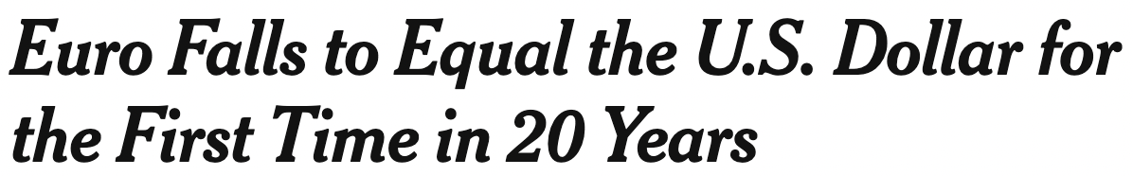
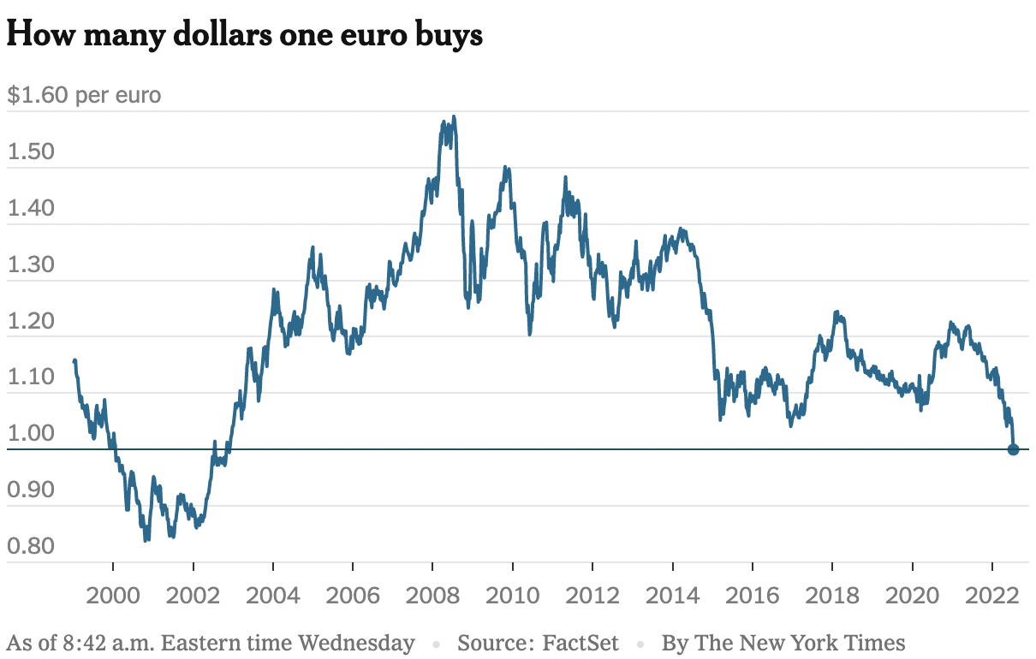

Dollar Value of Other Currencies
July 14, 2022
Notes:
https://www.nytimes.com/2022/07/13/business/euro-dollar-parity.html

Slide 48
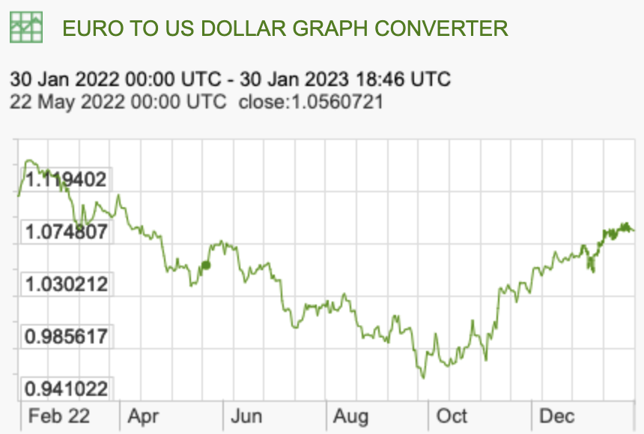
Dollar Value of Other Currencies
Euro
X-rates.com
Jan 30, 2023

Slide 49
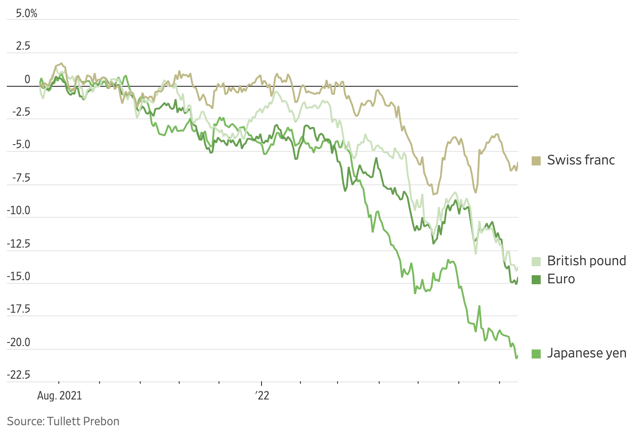

Dollar Value of Other Currencies
July 18, 2022
Notes:
https://www.wsj.com/articles/strong-dollar-extends-gains-with-no-end-to-rally-in-sight-11658066581?mod=itp_wsj&ru=yahoo

Slide 50
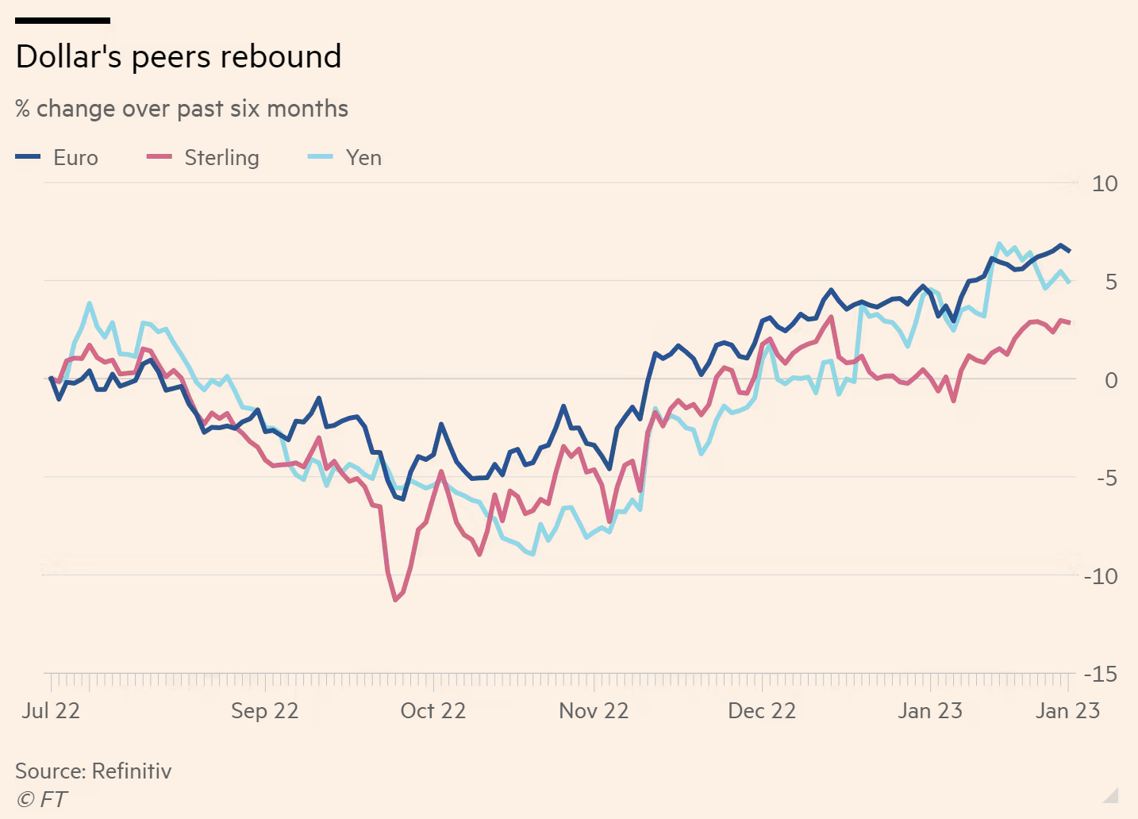
Dollar Value of Other Currencies
Source:
FT, 1/27/23
Notes:
Kate Duguid, “US dollar hits reverse gear as Fed cedes rate-rise ‘driver’s seat’,” Financial Times, January 27, 2023.
https://www.ft.com/content/84e98e21-0c89-486b-8ec9-b4c56c8af129

Slide 51
Dollar Value of Other Currencies
Unlike other countries, Canada let its exchange rate float 1950-1962
Source:
IMF International Financial Statistics
Notes:
https://data.imf.org/regular.aspx?key=61545850
Data for Presentations/IMF/Country Exchange Rates.xlsx
Domestic Currency per U.S. Dollar, Period Average, Rate, ENDA_XDC_USD_RATE, Units

Slide 52
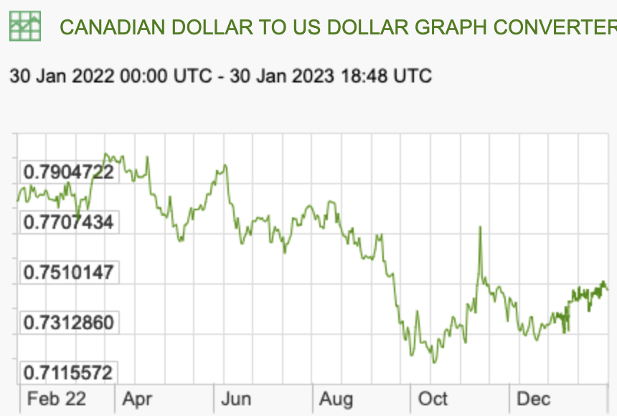
Dollar Value of Other Currencies
Canadian dollar
X-rates.com
Jan 30, 2023

Slide 53
Dollar Value of Other Currencies
1000 old pesos replaced by 1 new peso, Jan 1, 1993
Source:
IMF International Financial Statistics
Notes:
https://data.imf.org/regular.aspx?key=61545850
Data for Presentations/IMF/Country Exchange Rates.xlsx
Domestic Currency per U.S. Dollar, Period Average, Rate, ENDA_XDC_USD_RATE, Units

Slide 54
Dollar Value of Other Currencies
1000 old pesos replaced by 1 new peso, Jan 1, 1993
NAFTA
Peso Crisis aka Tequila Crisis
Source:
IMF International Financial Statistics
Notes:
https://data.imf.org/regular.aspx?key=61545850
Data for Presentations/IMF/Country Exchange Rates.xlsx
Domestic Currency per U.S. Dollar, Period Average, Rate, ENDA_XDC_USD_RATE, Units

Slide 55
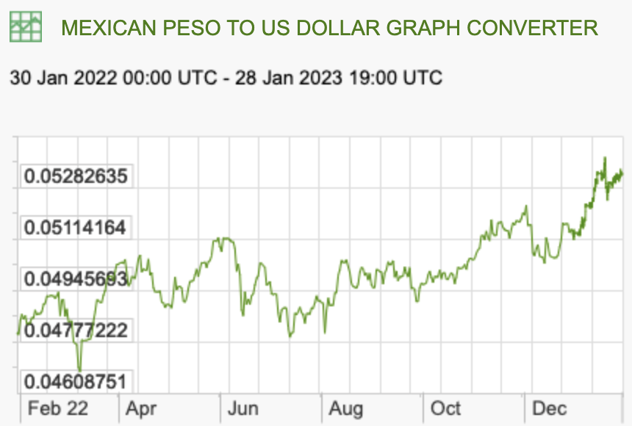
Dollar Value of Other Currencies
Mexican peso
X-rates.com
Jan 30, 2023

Slide 56
Dollar Value of Other Currencies
Source:
IMF International Financial Statistics
Notes:
https://data.imf.org/regular.aspx?key=61545850
Data for Presentations/IMF/Country Exchange Rates.xlsx
Domestic Currency per U.S. Dollar, Period Average, Rate, ENDA_XDC_USD_RATE, Units

Slide 57
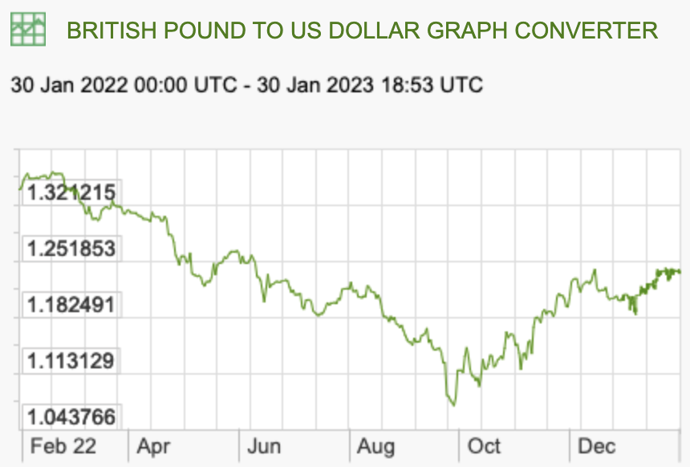
Dollar Value of Other Currencies
UK pound
X-rates.com
Jan 30, 2023

Slide 58
Dollar Value of Other Currencies
100 ¥/$ =
Source:
IMF International Financial Statistics
Notes:
https://data.imf.org/regular.aspx?key=61545850
Data for Presentations/IMF/Country Exchange Rates.xlsx
Domestic Currency per U.S. Dollar, Period Average, Rate, ENDA_XDC_USD_RATE, Units

Slide 59
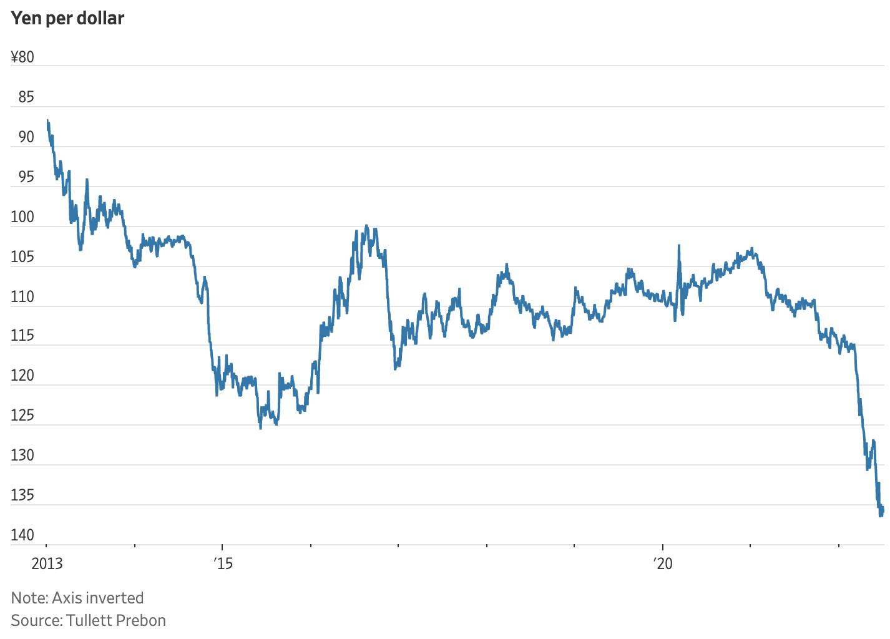
Dollar Value of Other Currencies
Recent drop since March 1, 2022
Source:
WSJ, 7/11/22
Notes:
James Mackintosh, “Strong Dollar Wins the Inflation Battle in New Spin on Currency Wars,” Wall Street Journal,” July 11, 2022
https://www.wsj.com/articles/strong-dollar-wins-the-inflation-battle-in-new-spin-on-currency-wars-11657369125?mod=itp_wsj&ru=yahoo

Slide 60
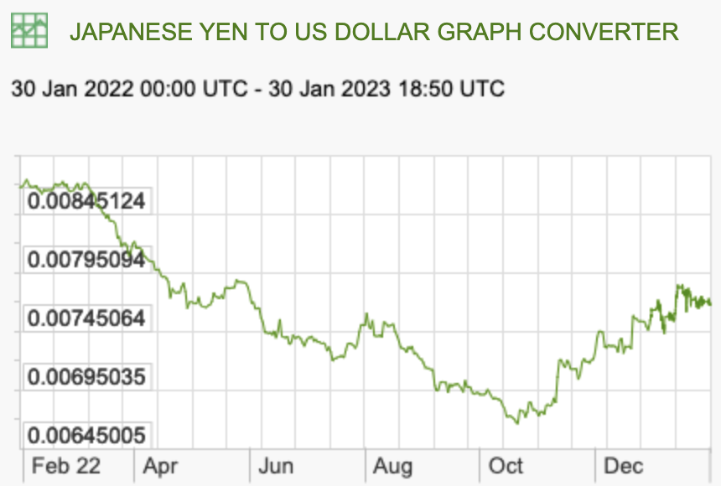
Dollar Value of Other Currencies
Japanese yen
X-rates.com
Jan 30, 2023

Slide 61
Dollar Value of Other Currencies
Rate has been “managed” by China. Some would say “manipulated.”
Source:
IMF International Financial Statistics
Notes:
https://data.imf.org/regular.aspx?key=61545850
Data for Presentations/IMF/Country Exchange Rates.xlsx
Domestic Currency per U.S. Dollar, Period Average, Rate, ENDA_XDC_USD_RATE, Units

Slide 62
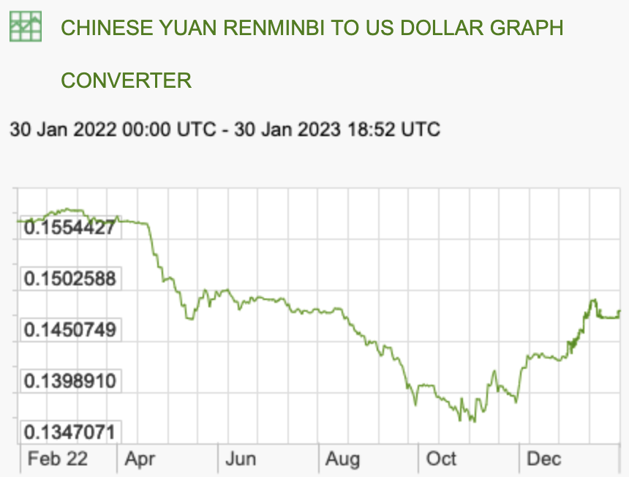
Dollar Value of Other Currencies
Chinese yuan
X-rates.com
Jan 30, 2023

Slide 63
How Exchange Rates Matter
Effects of an exchange rate depreciation
    (fall in value of the country’s currency)
  Trade
    Exports become less expensive and quantity likely rises
    Imports become more expensive and quantity likely falls
    Trade balance likely improves (surplus ↗︎ or deficit︎ ↘)
  Macroeconomic
    Raises domestic prices of imports and thus inflation
    If at full employment, real income falls, causing less spending
    If in recession, increased demand for products increases employment

Slide 64
How Exchange Rates Matter
More effects of an exchange rate depreciation
    (fall in value of the country’s currency)
  Domestic value of foreign assets and debts rises
    Net creditors gain, net debtors lose
      Effect on interest/dividend payments is opposite
    Those who have borrowed abroad to finance investment at home lose
      May go bankrupt
Effects of expectation of exchange rate depreciation
  Holders of assets in domestic currency try to sell and move abroad
  ↳ This speculative attack causes greater depreciation
  Example from 1997 Asian Crisis

Slide 65
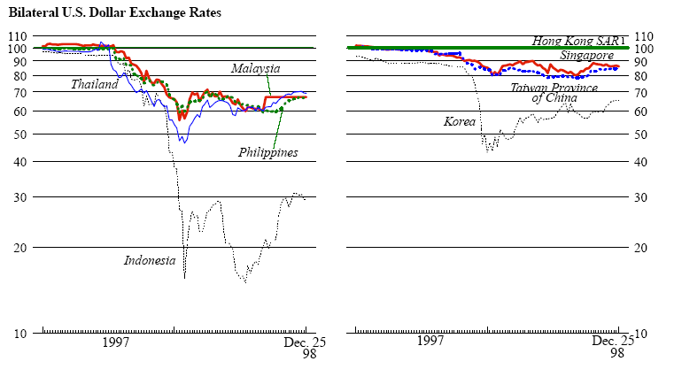
The Asian Crisis of 1997
Notes:
Source: IMF Fact Sheet January 1999:
http://www.imf.org/external/np/exr/facts/asia.htm
“The IMF's Response to the Asian Crisis”

Slide 66
The Asian Crisis of 1997
Thailand
Korea
Malaysia
Philippines
Indonesia
Notes:
https://data.imf.org/regular.aspx?key=61545850
Data for Presentations/IMF/Country Exchange Rates.xlsx

Slide 67
Currency Manipulation
Currency Manipulation
  Defined as
    Intervention in the exchange market by Central Bank or Government
    In order to push down, or keep down, the value of the currency
  Presumed purposes: To…
    Increase exports
    “Gain unfair advantage” in international trade and competitiveness
    Stimulate the domestic economy
    Accumulate foreign assets

Slide 68
Currency Manipulation
US Official Definition of Currency Manipulation
  US Treasury issues report on currency manipulation twice each year
  Criteria for manipulation
    Persistent net official purchases of foreign currency
      (more than 2 percent of GDP)
    A material trade (current account) surplus
      (more than 2 percent of GDP)
    A significant bilateral trade surplus with the United States
      (more than $20 billion per year)
Notes:
Gagnon, Joseph E., “Yellen Treasury looks the other way on currency manipulation,” Realtime Economic Issues Watch, PIIE, April 23, 2021.
https://www.piie.com/blogs/realtime-economic-issues-watch/yellen-treasury-looks-other-way-currency-manipulation

Slide 69
Currency Manipulation
US Treasury Report June 10, 2022
  “No major U.S. trading partner during 2021 manipulated the rate of exchange between its currency and the U.S. dollar for purposes of preventing effective balance of payments adjustments or gaining unfair competitive advantage in international trade.”
  “Switzerland meets all three criteria … over the four quarters through December 2021, and therefore Treasury is conducting enhanced analysis of Switzerland’s macroeconomic and exchange rate policies in this Report.
  12 economies are on “Monitoring List”: China, Japan, Korea, Germany, Italy, India, Malaysia, Singapore, Thailand, Taiwan, Vietnam, and Mexico
Look at data for two: Switzerland and China
Notes:
Gagnon, Joseph E., “Yellen Treasury looks the other way on currency manipulation,” Realtime Economic Issues Watch, PIIE, April 23, 2021.
https://www.piie.com/blogs/realtime-economic-issues-watch/yellen-treasury-looks-other-way-currency-manipulation

Slide 70
Currency Manipulation
Manipulation Criteria: Net Official Purchases of Foreign Currency (Reserves)
Was Rising
Notes:
IFS
Data for Presentations/IMF/Country Reserves.xlsx

Slide 71
Currency Manipulation
Manipulation Criteria: Net Official Purchases of Foreign Currency (Reserves)
Now Falling
Notes:
IMF, IFS, Data Tables, Data by Country, External Sector Selected Indicators
International Investment Positions, Reserve Assets, Net (with Fund Record), US Dollars, IARFR_BP6_USD, Millions
Jan 15, 2023
Data for Presentations/IMF/Country Reserves.xlsx

Slide 72
Currency Manipulation
Manipulation Criteria: Net Official Purchases of Foreign Currency (Reserves)
Not Rising (much)
Notes:
IMF, IFS, Data Tables, Data by Country, External Sector Selected Indicators
International Investment Positions, Reserve Assets, Net (with Fund Record), US Dollars, IARFR_BP6_USD, Millions
Jan 15, 2023
Data for Presentations/IMF/Country Reserves.xlsx

Slide 73
Currency Manipulation
Manipulation Criteria: Current Account Surpluses
China
Switzerland
Notes:
IMF, IFS, Data Tables, Data by Country, External Sector Selected Indicators
External Sector, Balance of Payments, Current Account, Goods and Services, Net, US Dollars, BGS_BP6_USD, Millions
Data for Presentations/IMF/Trade Balance 2 countries.xlsx

Slide 74
Currency Manipulation
Manipulation Criteria: US Bilateral Deficits
US Bilateral Trade Deficits larger than $20 billion
China | -923.2
Mexico | -365.8
Japan | -236.5
Germany | -104.9
Vietnam | -70.1
Ireland | -58.8
Italy | -58.5
Canada | -53.0
Malaysia | -33.7
Switzerland | -33.3
India | -28.4
Korea, Rep. | -25.5
Thailand | -24.7
US Bilateral Trade Surpluses larger than $20 billion
Netherlands | 20.3
Hong Kong, China | 25.9
Notes:
[This looks like it’s from The Economist, but I can’t now find it.

Slide 75
Currency Manipulation
Not Manipulation Criteria: Exchange Rates
8% drop
Notes:
IFS
Swiss Currency per U.S. Dollar, Period Average, ENDA_XDC_USD_RATE, Units
Jan 16, 2023
Data for Presentations/IMF/Exchange Rates/Switzerland Exchange Rate.xlsx

Slide 76
Currency Manipulation
Not Manipulation Criteria: Exchange Rates
11.0% drop
Notes:
IFS
Chinese Currency per U.S. Dollar, Period Average, ENDA_XDC_USD_RATE, Units
Jan 16, 2023
Data for Presentations/IMF/Exchange Rates/China Monthly Exchange Rates.xlsx

Slide 77
Currency Manipulation
US Treasury Report November, 2022
  “[The U.S.] Treasury has concluded that no major trading partner of the United States engaged in [currency manipulation] during the relevant period.”
  “Switzerland once again exceeded the thresholds for all three criteria...”
  “Italy, India, Mexico, Thailand, and Vietnam have been removed from the Monitoring List in this Report, having met only one out of three criteria for two consecutive Reports..”
  “In this Report, the Monitoring List comprises China, Japan, Korea, Germany, Malaysia, Singapore, and Taiwan.” (7 countries)
  “China’s failure to publish foreign exchange intervention and broader lack of transparency around key features of its exchange rate mechanism make it an outlier among major economies and warrants Treasury’s close monitoring.”
Notes:
“Macroeconomic and Foreign Exchange Policies of Major Trading Partners of the united States”
REPORT TO CONGRESS, U.S. DEPARTMENT OF THE TREASURY, OFFICE OF INTERNATIONAL AFFAIRS, November 2022
https://home.treasury.gov/system/files/206/November_2022_FXR_FINAL.pdf

Slide 78
Next Week
Topic
Speaker
From

Slide 79
Thank you!
Any Questions?
www.NEEDelegation.org
Alan Deardorff
alandear@umich.edu
Contact NEED: info@NEEDelegation.org
Submit a testimonial: www.NEEDelegation.org/testimonials.php
Become a Friend of NEED: www.NEEDelegation.org/friend.php

